Slide 1
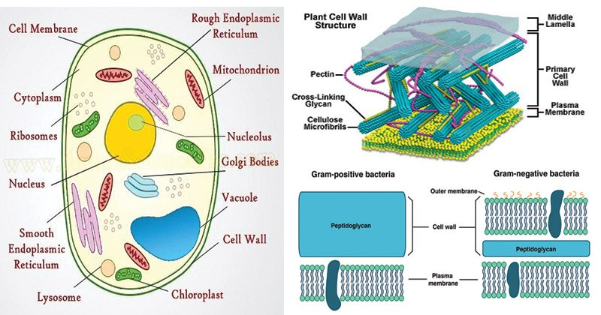
Cell Structure
The cell is the basic structural and functional unit of life
The cell was first discovered by Robert Hooke in 1665
A cell consists of cell wall, cell membrane, cytoplasm, nucleus, and cell organelles.
Main Cell Functions
Provide Structure and Support
Facilitate Growth Through Mitosis
Allow Passive and Active Transport
Produce Energy
Create Metabolic Reactions
Aids in Reproduction.
Interstitial fluid or extracellular fluid

Slide 2
Cell Membrane
The cell membrane or plasma membrane (PM) or cytoplasmic membrane, and or plasmalemma is a biological membrane that separates the interior of all cells from the outside environment (the extracellular space) which protects the cell from its environment.
Serves as outer boundary.
Communication with environment- act as barrier, determines what enters or leaves, detects and responds to the change.
The plasma membrane exhibits selective permeability, allowing some substances to cross it more easily than others
~5-10 nm thick.
Living, dynamic, elastic, undergoes renewal.
Eukaryotic cells have extensive intracellular membranes too.
PM + subcellular membranes= Biological membrane/ biomemembrane

Slide 3
Various models of Plasma membrane: The four historical models of Plasma Membrane are:
1. Lipid (1895) and Lipid Bilayer Model (1925-26)
2. Dannelli Model. (1935)
3. Unit Membrane Model (Protein-Lipid Bilayer-Protein) (1953)
4. Fluid Mosaic Model (1972)

Slide 4
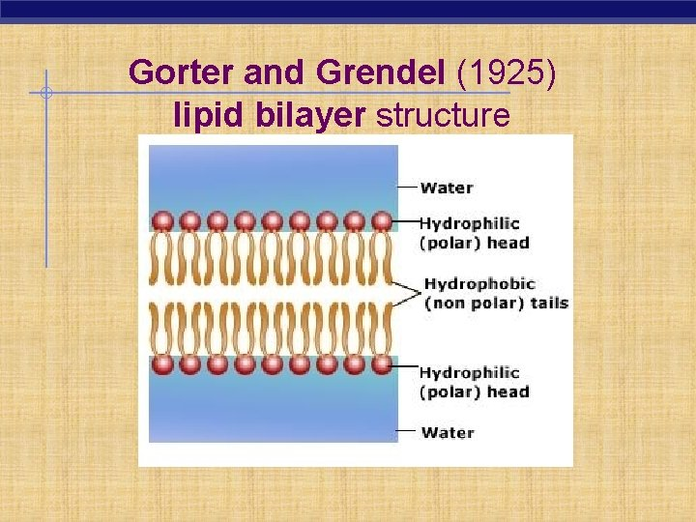
1. Lipid and Lipid Bilayer Model (1925-26)
Overton’s suggestion (1895)- Composed of lipids based on findings that lipid-soluble substances entered the cells much more readily than water-soluble materials. Further Langmuir suggested ampipathic nature of lipids
Gorter and Grendel model (1925)- Dutch, composed of lipid bilayer (RBCs).
The membrane consisted of double layers of lipid molecules, the polar hydrophilic groups of the molecules being situated on the outside and hydrophobic ends standing at right angles to the surface are oriented inwardly. These models of Gorter and Grendel could not explain the proper structure of plasma membrane but they put the foundation of future models of membrane structure.

Slide 5
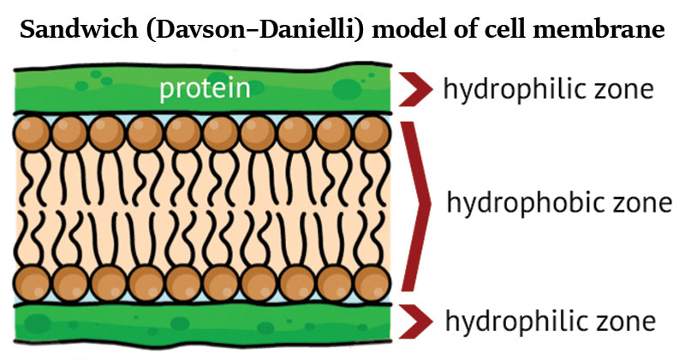
2 Danielli and Davson model (1935)- James Danielli and Hugh Davson proposed a sandwich model or lamellar theory in which the phospholipid bilayer lies between two monolayers of globular proteins.
Danielli and Davson model was the first attempt to describe membrane structure in terms of molecules and to relate the structure to biological and chemical properties.
According to bimolecular model of Danielli and Davson, plasma membrane consists of two layers of phospholipid molecules (a bimolecular leaflet) in which phospholipid molecules are arranged in such a way that hydrophilic heads of the phospholipid molecules face outside and hydrophobic non-polar lipid chains are associated in the inner region of leaflet.
The hypothesis also suggested that the polar ends of lipid molecules are associated with monomolecular layer of globular proteins. The membrane would thus consist of a double layer of phospholipid molecules sandwiched between two essentially continuous layers of protein.

Slide 6
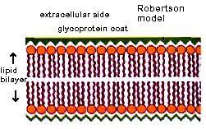
Robertson model (1965)- Unit membrane hypothesis according to which all biological membranes show generalized unit membrane construction. The unit membrane model visualizes cell membrane as a trilaminar and indicates structure consisting of two dark osmiophilic layers separated by a light osmiophilic layer. Trilaminar appears with a bimolecular lipid layer between two protein layers. Each dense osmiophilic band is made up of protein (20 Å) and the polar groups of phospholipids (5 Å) and is thus 25 Å thick. The clear Osmiophilic zone 25 A in thickness is a bimolecular layer of lipids without the polar groups. In other words, the unit membrane is 75 Å thick with a 35 Å thick phospholipid layer between two 20 Å thick protein layers.

Slide 7
Fluid mosaic model
In 1972, S. J. Singer and G. Nicolson proposed that the membrane is a mosaic of proteins dispersed within the bilayer, with only the hydrophilic regions exposed to water.
The fluid mosaic model describes the structure of the plasma membrane as a mosaic of components—including phospholipids, cholesterol, proteins, and carbohydrates—that gives the membrane a fluid character. Fluidity allow the mem. to stretch and reseal, further proteins to move within it Plasma membranes range from 5 to 10 nm in thickness.
The proportions of proteins, lipids, and carbohydrates in the plasma membrane vary with cell type. For example, myelin contains 18% protein and 76% lipid. The mitochondrial inner membrane contains 76% protein and 24% lipid.
Phospholipid- are amphipathic (hydrophobic and –philic regions), arrangement act as water resistant barrier- allow only lipid materials to pass.
Proteins are of two types integral that go across the membrane serving as membrane transporters and peripheral that loosely attach to the outer (peripheral) side of the cell membrane, acting as enzymes shaping the cell

Slide 8
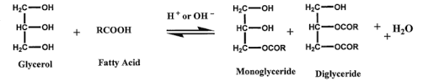
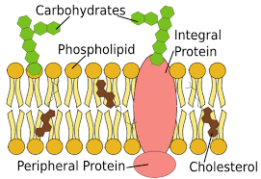
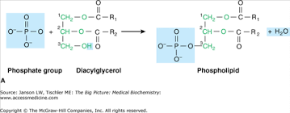
The Cell Membrane Structure
Polar head
Lipophilic
Tail
(Amphipathic molecule)
Cell membrane
Cytoplasm
Interstitial fluid
or extracellular fluid

Slide 9
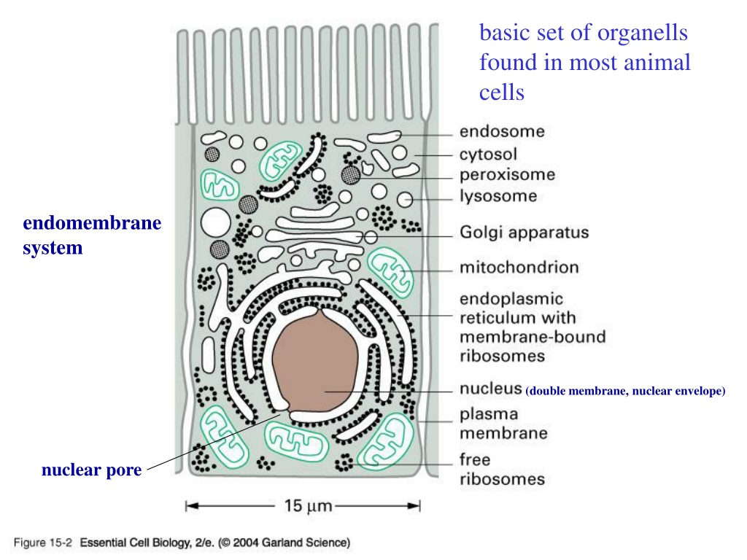
The Intracellular Compartment
The intracellular compartment is the space within the organism's cells; it is separated from the extracellular compartment by cell membranes
Each eucaryotic cell is subdivided into many enclosed compartments where many metabolic processes are carried out
Separating cellular compartments is necessary for the reactions not to mix and be carried out simultaneously
Many enzymes, reactions, substrates, and products are actively synthesized and degraded
The cytosol
Endoplasmic reticulum
Golgi apparatus
Nucleus
Mitochondrion
Endosome,
Lysosome,
Peroxisome

Slide 10
The Main Functions of the Membrane-enclosed Compartments of a Eucaryotic Cell
COMPARTMENT | MAIN FUNCTION
Cytosol | signal transduction between the cell membrane and the nucleus and organelles, It transports metabolites from their production site to other parts of the cell
Nucleus | Controls and regulates the activities of the cell (e.g., growth and metabolism) and carries the genes, structures that contain the hereditary information
Golgi apparatus | modification, sorting and packaging of proteins and lipids for either secretion or delivery to another orgenelles called as factory house
Endoplasmic reticulum (ER) sphere-shaped sacs filled with hydrolytic enzymes | Syntheis of most lipids, synthesis, folding, modification, and transport of proteins, membrane biogenesis
Lysosome | The digestive system of the cell (intracellular degradation), called as suicide bags.
Endosomes | sorting of endocytosed material regulate trafficking of proteins and lipids among other subcellular compartments
Mitrochondria | ATP synthesis by oxidative phosphorylation, power house of the cell
Chloroplasts (in plant cells) | ATP synthesis and carbon fixation by photosynthesis
Peroxisomes | Oxidation of toxic molecules
:
:

Slide 11
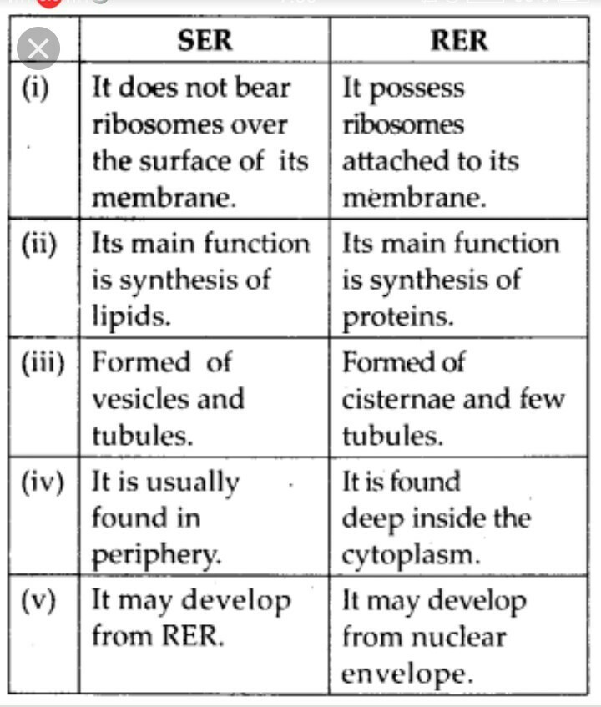
Difference between SER and RER
SER: Smooth endoplasmic reticulum
RER: Rough endoplasmic reticulum

Slide 12
Why are Lysosomes known as Suicidal Bags
Lysosomes work as the waste discarding structures of the cell by processing undesirable materials and degrading them, both from the exterior of the cell and waste constituents inside the cell.
But sometimes, the digestive enzymes may end up damaging the lysosomes themselves, and this can cause the cell to die. This is termed as autolysis, where “auto” means “self” and “lysis” means “the disintegration of the cell by the destruction of its cell membrane“.
Hence, lysosomes are known as “Suicidal Bags” of the cell.

Slide 13
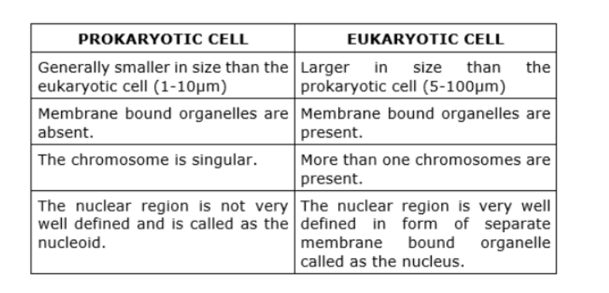
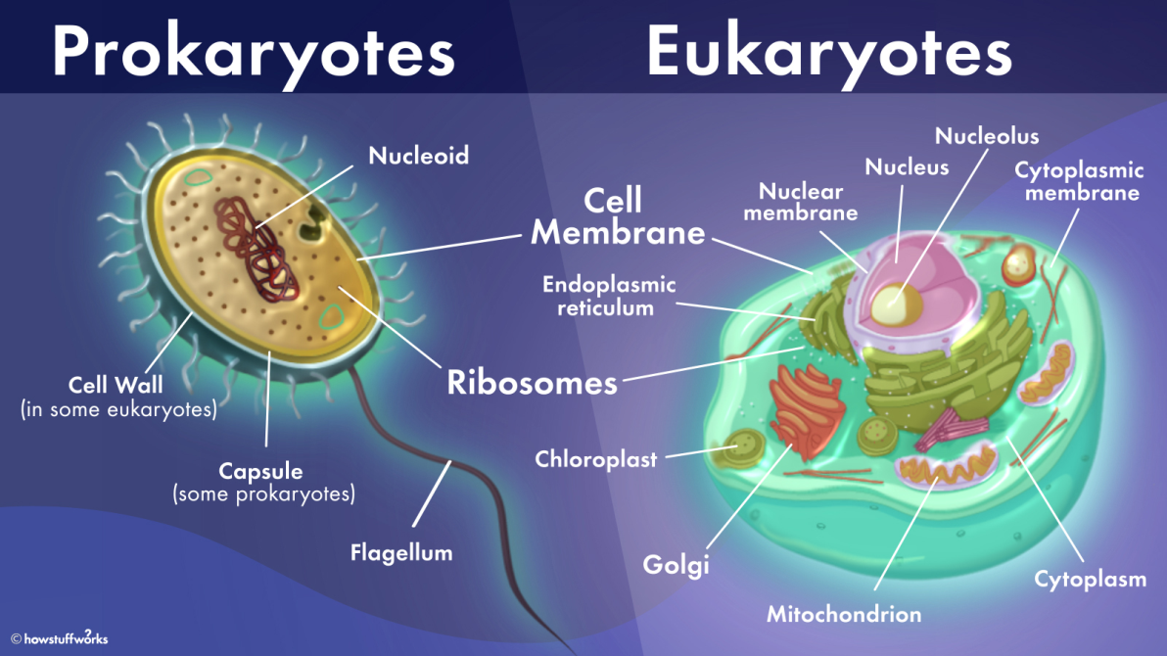

Slide 14

School of Basic and Applied Sciences
Course Code : BB01T1008 Course Name: Biology of Engineers
Carbohydrates
A carbohydrate is a polyhydroxy aldehyde, a polyhydroxy ketone, or a compound that yields polyhydroxy aldehydes or polyhydroxy ketones upon hydrolysis. The carbohydrate glucose is a polyhydroxy aldehyde, and the carbohydrate fructose is a polyhydroxy ketone.
Most simple carbohydrates have empirical formulas that fit the general formula CnH2nOn
Classification of carbohydrates
Carbohydrates are classified on the basis of molecular size as monosaccharides, oligosaccharides, and polysaccharides.

Slide 15
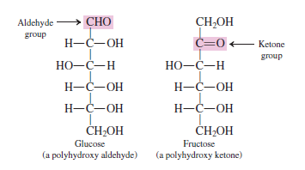
School of Basic and Applied Sciences
Course Code : ENVS1001 Course Name: Environmental Science
Monosaccrides
4
A monosaccharide is a carbohydrate that contains a single polyhydroxy aldehyde or polyhydroxy ketone unit.
Monosaccharides cannot be broken down into simpler units by hydrolysis reactions. Both glucose and fructose are monosaccharides.
Naturally occurring monosaccharides have from three to seven carbon atoms; five- and six-carbon species are especially common.
Pure monosaccharides are water-soluble, white, crystalline solids.
Monosaccharides are classified as aldoses or ketoses on the basis of type of carbonyl group present. An aldose is a monosaccharide that contains an aldehyde functional group. Aldoses are polyhydroxy aldehydes.
A ketose is a monosaccharide that contains a ketone functional group. Ketoses are polyhydroxy
ketones.

Slide 16
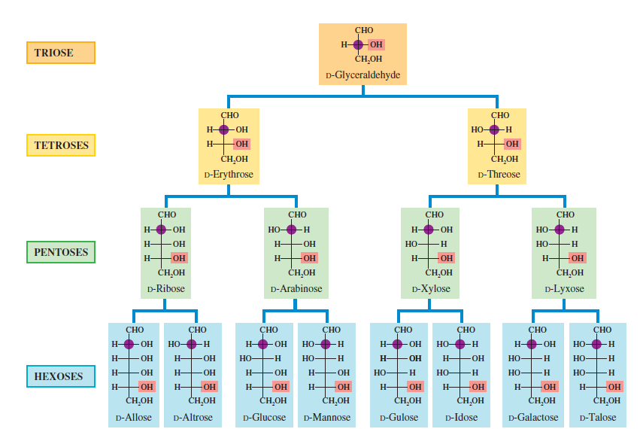
Aldoses

Slide 17
School of Basic and Applied Sciences
Course Code : ENVS1001 Course Name: Environmental Science
Disaccharides
3
A disaccharide is a carbohydrate that contains two monosaccharide units covalently bonded to each other.
Like monosaccharides, disaccharides are crystalline, water soluble substances. Sucrose (table sugar) and lactose (milk sugar) are disaccharides.
Free oligosaccharides, other than disaccharides, are seldom encountered in biochemical systems.
Complete hydrolysis of an oligosaccharide produces monosaccharides
Oligosaccharides
An oligosaccharide is a carbohydrate that contains two to ten monosaccharide units
covalently bonded to each other. Disaccharides are the most common type of oligosaccharide.

Slide 18
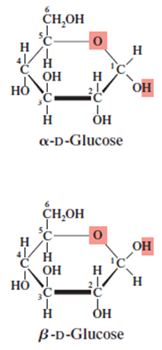
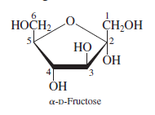
5 and 6 membered monosaccharides
School of Basic and Applied Sciences
Course Code : ENVS1001 Course Name: Environmental Science
Polysaccharides
5
A polysaccharide is a polymeric carbohydrate that contains many monosaccharide units covalently bonded to each other.
Polysaccharides often contain several thousand monosaccharide units. Both cellulose and starch are polysaccharides.

Slide 19
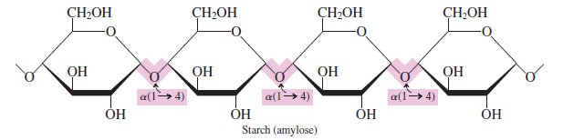
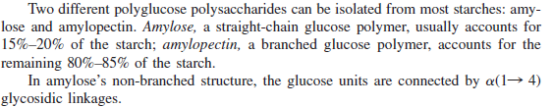
Starch
7

Slide 20
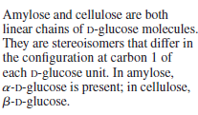
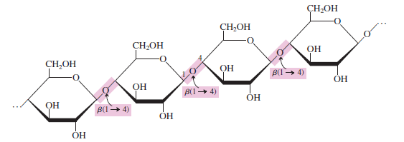
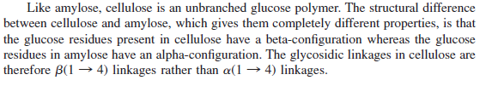
School of Basic and Applied Sciences
Course Code : ENVS1001 Course Name: Environmental Science
Cellulose
9

Slide 21
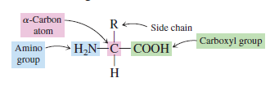
School of Basic and Applied Sciences
Course Code : ENVS1001 Course Name: Environmental Science
PROTEINS
10
Proteins are needed for the synthesis of enzymes, certain hormones, and some blood components; for the maintenance and repair of existing tissues; for the synthesis of new tissue; and sometimes for energy.
A protein is a naturally occurring, unbranched polymer in which the monomer units are amino acids.
An amino acid is an organic compound that contains both an amino (! NH2) group and a carboxyl (! COOH) group. The amino acids found in proteins are always a-amino acids. An -amino acid is an amino acid in which the amino group and the carboxyl group are attached to the -carbon atom.
Over 700 different naturally occurring amino acids are known, but only 20 of them, called standard amino acids, are normally present in proteins. A standard amino acid is one of the 20 a-amino acids normally found in proteins
A polar neutral amino acid is an amino acid that contains one amino group, one carboxyl group, and a side chain that is polar but neutral.
A polar acidic amino acid is an amino acid that contains one amino group and two carboxyl groups, the second carboxyl group being part of the side chain.
A polar basic amino acid is an amino acid that contains two amino groups and one carboxyl group, the second amino group being part of the side chain.

Slide 22
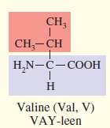
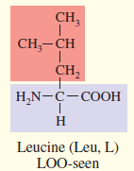
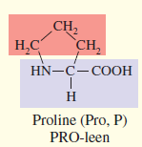
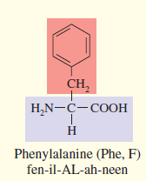
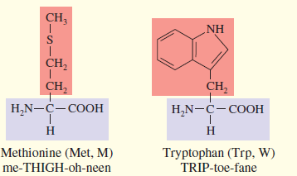
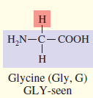
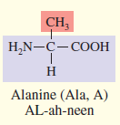
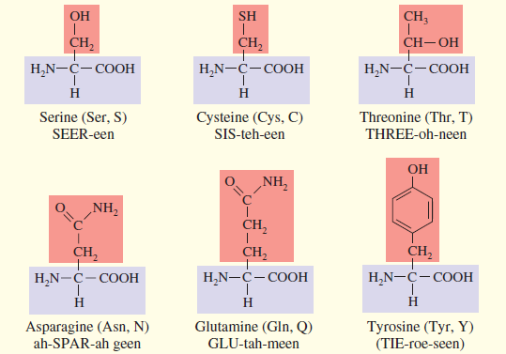
School of Basic and Applied Sciences
Course Code : ENVS1001 Course Name: Environmental Science
Non polar aminoacids
12
Non-polar amino acids are a class of amino acids in which the variable R-group is comprised of mostly hydrocarbons. the amino acids cysteine and methionine also feature a sulphur atom, but (due to its similar negativity to carbon) this does not confer any polar properties to either of these amino acids
Polar neutral aminoacids

Slide 23
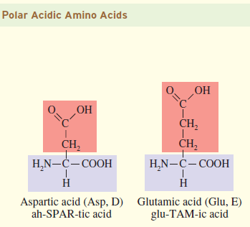
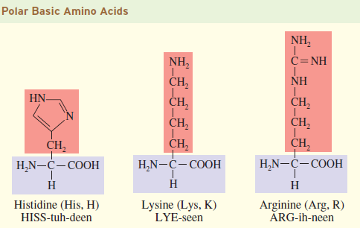
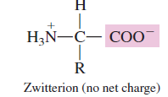
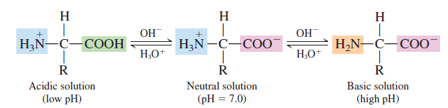
School of Basic and Applied Sciences
Course Code : ENVS1001 Course Name: Environmental Science
Polar aminoacids
15
Aminoacids

Slide 24
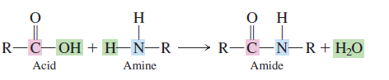
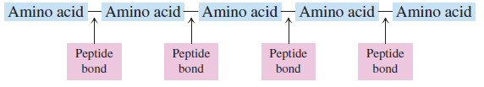
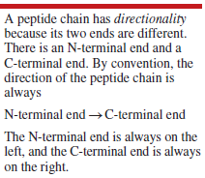
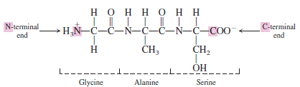
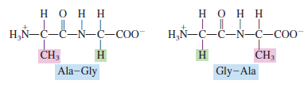
Peptide
19
A peptide is an unbranched chain of amino acids, each joined to the next by a peptide bond.
A peptide bond is a covalent bond between the carboxyl group of one amino acid and the amino group of another amino acid.
Isomeric peptide

Slide 25
School of Basic and Applied Sciences
Course Code : ENVS1001 Course Name: Environmental Science
Proteins
21
More than one peptide chain may be present in a protein. On this basis, proteins are classified as monomeric or multimeric.
A monomeric protein is a protein in which only one peptide chain is present. Large proteins, those with many amino acid residues, usually are multimeric.
A multimeric protein is a protein in which more than one peptide chain is present. The peptide chains present in multimeric proteins are called protein subunits.
Protein classification
Proteins, on the basis of chemical composition, are classifi ed as simple or complex.
A simple protein is a protein in which only amino acid residues are present. More than one protein subunit may be present in a simple protein, but all subunits contain only amino acids.
A conjugated protein is a protein that has one or more nonamino
acid entities present in its structure in addition to one or more peptide chains.
These non-amino acid components, which may be organic or inorganic, are called prosthetic groups. A prosthetic group is a non-amino acid group present in a conjugated protein.

Slide 26
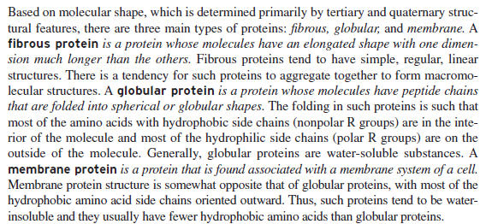
School of Basic and Applied Sciences
Course Code : ENVS1001 Course Name: Environmental Science
Protein classification
24

Slide 27
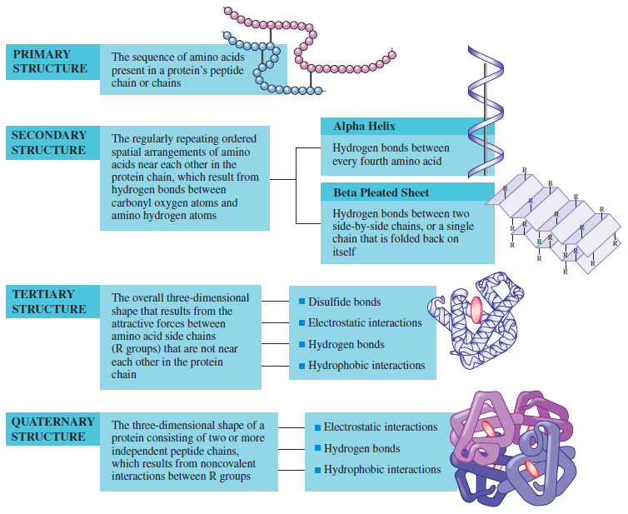
School of Basic and Applied Sciences
Course Code : ENVS1001 Course Name: Environmental Science
Protein structure
24

Slide 28
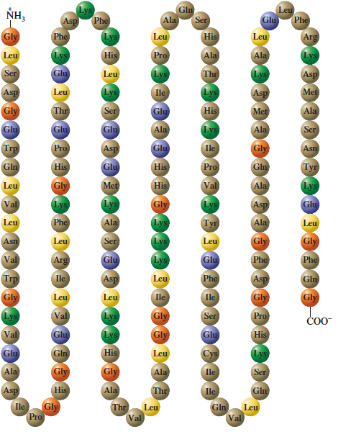
School of Basic and Applied Sciences
Course Code : ENVS1001 Course Name: Environmental Science
Primary structure of Proteins
24

Slide 29
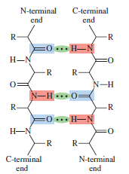
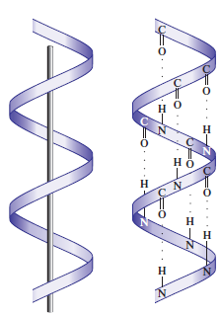
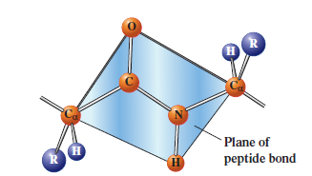
Secondary structure

Slide 30
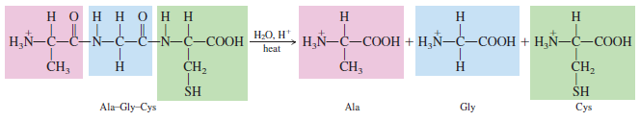
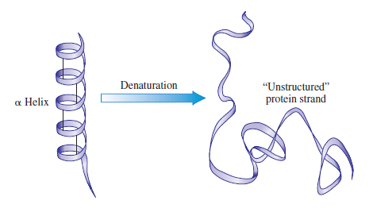
Protein ( hydrolysis, denaturation)

Slide 31
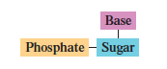
Nucleic acids (DNA, RNA)
All nucleic acid molecules are polymers. A nucleic acid is a polymer in which the monomer units are nucleotides
A nucleotide is a three-subunit molecule in which a pentose sugar is bonded to both a phosphate group and a nitrogen-containing heterocyclic base

Slide 32
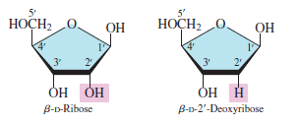
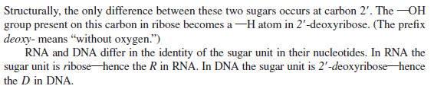
Sugar

Slide 33
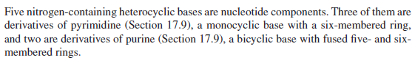



Nitrogen containing heterocyclic bases

Slide 34


Phosphate

Slide 35


Nucleotide formation

Slide 36

Nucleotides

Slide 37

Nucleotides

Slide 38


General backbone of nucleic acids

Slide 39


DNA

Slide 40


Comparison to protein structure

Slide 41


Base pairing

Slide 42


Central Dogma
The 'Central Dogma' is the process by which the instructions in DNA are converted into a functional product. It was first proposed in 1958 by Francis Crick, discoverer of the structure of DNA.Jan 25, 2016

Slide 43

Lipids
A lipid is an organic compound found in living organisms that is insoluble (or only sparingly soluble) in water but soluble in nonpolar organic solvents.

Slide 44

Lipids

Slide 45



Slide 46


Slide 47

Phospholipid

Slide 48

Glycerophospholipid

Slide 49


Sphingophospholipds

Slide 50

Sphingoglycolipid

Slide 51


Slide 52

Central dogma- DNA → RNA → Protein
Central dogma is the process in which the genetic information flows from DNA to RNA, to make a functional product protein. It was first proposed in 1958 by Francis Crick, discoverer of the structure of DNA

Slide 53
Central Dogma Steps
The central dogma takes place in two different steps:
Transcription -DNA to RNA
Transcription is the process by which the information is transferred from one strand of the DNA to RNA by the enzyme RNA Polymerase. The DNA strand which undergoes this process consists of three parts namely promoter, structural gene, and a terminator.
The DNA strand that synthesizes the RNA is called the template strand and the other strand is called the coding strand. The DNA-dependent RNA polymerase binds to the promoter and catalyzes the polymerization in the 3′ to 5′ direction.
As it approaches the terminator sequence, it terminates and releases the newly synthesized RNA strand. The newly released RNA strand further undergoes post-transcriptional modifications.
Translation -RNA to Protein
Translation is the process by which the RNA codes for specific proteins. It is an active process which requires energy. This energy is provided by the charged tRNA molecules.
Ribosomes initiate the translation process. The ribosomes consist of a larger subunit and a smaller subunit. The larger subunit, in turn, consists of two tRNA molecules placed close enough so that peptide bond can be formed at the expense of enough energy.
The mRNA enters the smaller subunit which is then held by the tRNA molecules of the complementary codon present in the larger subunit. Thus, two codons are held by two tRNA molecules placed close to each other and a peptide bond is formed between them. As this process repeats, long polypeptide chains of amino acids are synthesized.

Slide 54
mRNA, tRNA, and rRNA are the three major types of RNA involved in protein synthesis. The mRNA (or messenger RNA) carries the code for making a protein. In eukaryotes, it is formed inside the nucleus and consists of a 5′ cap, 5’UTR region, coding region, 3’UTR region, and poly(A) tail. The copy of a DNA segment for gene expression is located in its coding region. It begins with a start codon at 5’end and a stop codon at the 3′ end. tRNA (or transfer RNA), as the name implies, transfers the specific amino acid to the ribosome to be added to the growing chain of amino acid. It consists of two major sites: (1) anticodon arm and (2) acceptor stem. The anticodon arm contains the anticodon that complementary base pairs with the codon of the mRNA. The acceptor stem is the site where a specific amino acid is attached (in this case, the tRNA with amino acid is called aminoacyl-tRNA). A peptidyl-tRNA is the tRNA that holds the growing polypeptide chain. Unlike the first two, rRNA (or ribosomal RNA) does not carry genetic information. Rather, it serves as one of the components of the ribosome. The ribosome is a cytoplasmic structure in cells of prokaryotes and eukaryotes that are known for serving as a site of protein synthesis. The ribosomes can be used to determine a prokaryote from a eukaryote. Prokaryotes have 70S ribosomes whereas eukaryotes have 80S ribosomes. Both types, though, are each made up of two subunits of differing sizes. The larger subunit serves as the ribozyme that catalyzes the peptide bond formation between amino acids. rRNA has three binding sites: A, P, and E sites. The A (aminoacyl) site is where aminoacyl-tRNA docks. The P (peptidyl) site is where peptidyl-tRNA binds. The E (exit) site is where the tRNA leaves the ribosome.

Slide 55
School of Basic and Applied Sciences
Course Code : BBS01T1008 Course Name: Biology of Engineers
THANK YOU…

